Slide 1



.NET Overview and Roadmap
Covering up to .NET Core 3 and //BUILD updates ☺
MahesKBlr

Slide 2
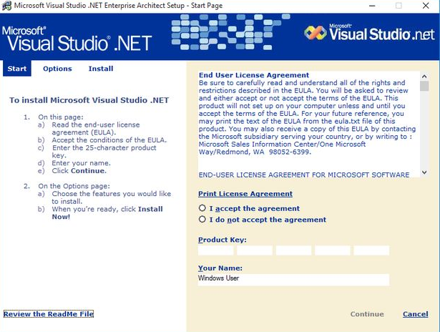
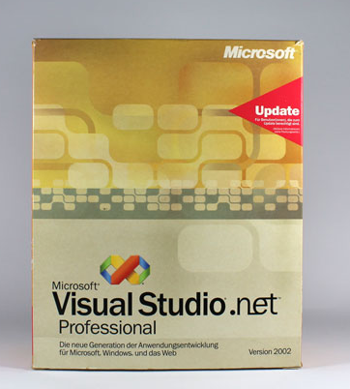

Slide 3
.NET
Free. Cross-platform. Open source.
A developer platform for building all your apps.
www.dot.net

Slide 4














Your platform for building anything
DESKTOP
WEB
CLOUD
MOBILE
GAMING
IoT
AI
.NET
Notes:
You can build anything with .NET. We’ve made significant investments in .NET over the years as well as unifying the ecosystem to support building literally anything. From desktop to gaming to the cloud, .NET is a general purpose programming platform that enables all kinds of scenarios. Once you learn one, you can easily pick up another.

Slide 5
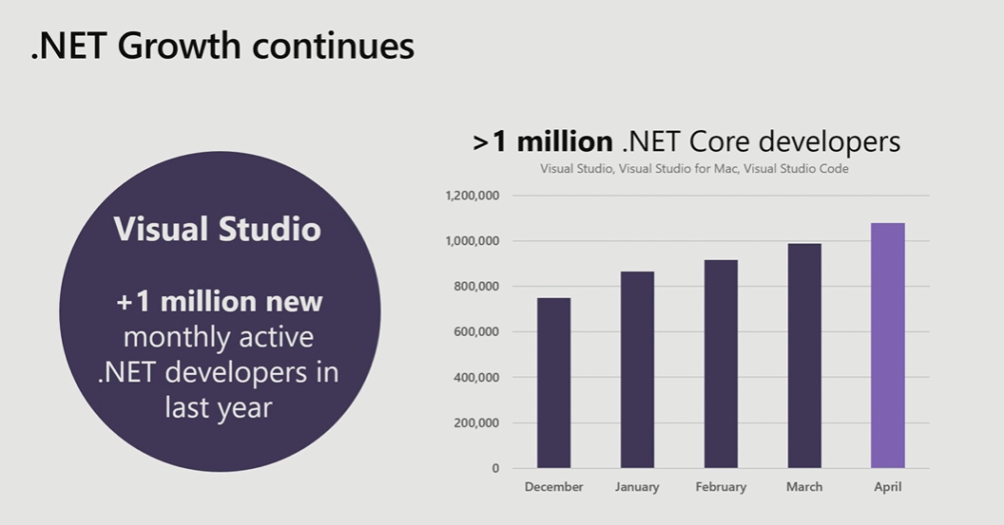

Slide 6
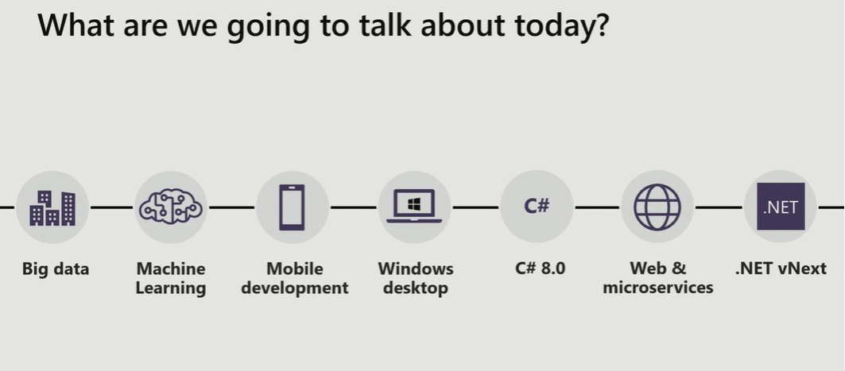
//BUILD update

Slide 7


.NET Open Source journey
.NET
2001
ECMA 335
2008
ASP.NET MVC (web platform) open source
April 2014
.NET Compiler Platform (“Roslyn”) open source
.NET Foundation founded
2016
Mono project joins .NET Foundation
June 2018
.NET Core 2.1 released
Aug. 2017
.NET Core 2.0 released
Dec. 2018
WinForms and WPF
Open Source
2002
NET 1.0 for Windows released. Mono project begins
Nov. 2014
.NET Core (cross-platform) project begins
Notes:
Dec 2001-Feb 2002.
A new platform is born. Along with HP, Intel and others, the ECMA-335 standard was created that defined a common language infrastructure to support multiple programming languages. C# and Visual Basic.NET were released and F# came later in 2007, but there are over 20 other .NET languages today. Visual Studio .NET was released and included C#, VB, C++ development all in one box. This was the first IDE that was truly integrated across multiple languages.
Mono project begins. The CLI spec gave others the ability to create their own .NET implementations. Even though Microsoft built the first .NET Framework for Windows-only, the spec was intentionally portable across OSes and chipsets. The Mono project began, spearheaded by Miguel de Icaza, with the goal to implement Microsoft's new .NET development platform on Linux and Unix-like platforms. Later, Miguel started Xamarin which focused on cross-platform, native, mobile development with C#, built upon Mono. This allows developers to use C# and .NET to build apps for iOS and Android. Unity games development also emerged from Mono.
2008.
ASP.NET MVC web development stack is released to CodePlex as open source. This was the first application development framework from Microsoft to be released as open source. The underlying runtime and compilers were still closed however.
2014.
Hell freezes over & pigs fly. Early 2014 at Microsoft’s BUILD conference, Anders Hejlsberg, the father of C#, releases the .NET Compiler Platform “Roslyn” as open source on stage. Later in November, .NET Core project begins in the open. The technology world is shocked, and the .NET community is excited. .NET Core is a new cloud-native implementation of .NET that is geared for cross-platform, hyper-scale services as well as small IoT devices. It’s meant to bring .NET into the next 15 years of computing. And the community has been extremely supportive….
2016.
Mono comes home. In early 2016, Microsoft finally acquires Xamarin and brings Miguel de Icaza into Developer Division. Mono joins the .NET foundation and is officially supported and contributed to by Microsoft. The Microsoft community officially meets the Mono community.
2017.
.NET Core 2.0 Released. Our cross platform and open source implementation of .NET finally releases to the world with unified tooling support across multiple operating systems and editors.

Slide 8

.NET open source success
“Samsung is embracing .NET because it is a completely open source project.”
—Samsung
“.NET is open source; that allows us to contribute back to it if we have any performance issues which Microsoft review and together we make a better product.”
—Illyriad Games
61,000+ community contributions from 3700+ companies outside Microsoft
Notes:
We’ve seen companies taking a bet on .NET because it’s a completely open source project now. More than 20,000 contributors* from 3700 companies have contributed to .NET Core and related open source repositories, with over half of the contributions coming from outside Microsoft.
In the last year we have seen over half a million developers use .NET Core, the cross-platform, high-performance, implementation of .NET.
*contributor = Submitted a Pull Request or Created an Issue. Data up to March 2018.

Slide 9
.NET Core 2.2 now available
ANNOUNCING
www.dot.net/download
Notes:
We’re also announcing today the first preview of .NET Core 3. It comes with significant updates to desktop and server workloads.
.NET Core 3 brings Windows desktop development to .NET Core, with support for WinForms and WPF.
It enables more flexible deployment with side-by-side and self-contained EXEs.
We also have new features on the server side, including composable UIs with ASP.NET Core with Razor Components, which will provide full-stack web development with .NET for the first time.

Slide 10
.NET Core 2.2 themes
Improved Web API development
Microservices and Azure
Continued performance improvements

Slide 11
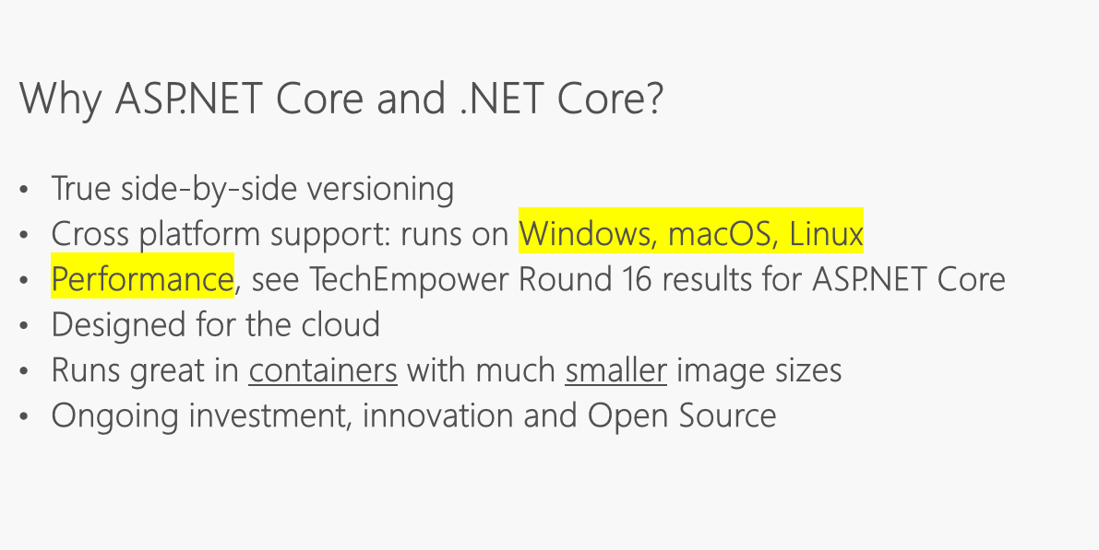

Slide 12
Techempower demo
www.dot.net/download
Notes:
We’re also announcing today the first preview of .NET Core 3. It comes with significant updates to desktop and server workloads.
.NET Core 3 brings Windows desktop development to .NET Core, with support for WinForms and WPF.
It enables more flexible deployment with side-by-side and self-contained EXEs.
We also have new features on the server side, including composable UIs with ASP.NET Core with Razor Components, which will provide full-stack web development with .NET for the first time.

Slide 13
.NET Core 2.2 major features
.NET Core
EF Core
ASP.NET Core
Multi-tier JIT compilation
SQL Connection token auth
Cosmos DB provider (moved to 3.0)
Spatial extensions for SQL Server and SQLite providers
Reverse engineering of database views
Collections of owned entities
Query tagging
Template updates: Bootstrap 4, Angular 6
Web API improvements, including API security
HTTP/2
IIS in-process hosting
Health checks
Endpoint routing
SignalR Java client
ASP.NET Core SignalR (2.1)

Slide 14
Demo #1 :Retry HTTP Client .NET Core 2.2
Notes:
HTTP/2, API security, show the meetup or GitHub API / show swagger
Bootstrap 4 template updates
Angular templates
-- 8min

Slide 15










Azure is YOUR cloud .NET cloud apps run best in Azure
Azure Storage
Azure Cosmos DB
Azure App service
Azure Functions
Azure App Insights
Azure Service Fabric
Azure SignalR Service
Azure Virtual Machines
Azure SQL Database
Azure Cognitive Services
Azure Kubernetes Service (AKS)
And many more…
Extend apps with serverless, event driven tasks
Commoditized AI
Fully managed platform perfect for running .NET Framework and .NET Core web aps and services
Application performance and usability monitoring
Build native .NET, fully managed, scalable microservices
Relational database
Non-relational database
Fully managed real-time web functions, like chat, gaming, tickers, collaboration and more
Store anything
Great for binaries
Container orchestrator for Linux workloads (.NET Core)
Notes:
Azure is the .NET developer’s cloud. There are hundreds of developer services accessible to C# developers. From fully managed platform as a service with App Service, to serverless event driven Azure functions to relational and non-relational databases, the .NET developer is a primary target customer. We make developing against these services as integrated and productive as a .NET developer would expect.

Slide 16

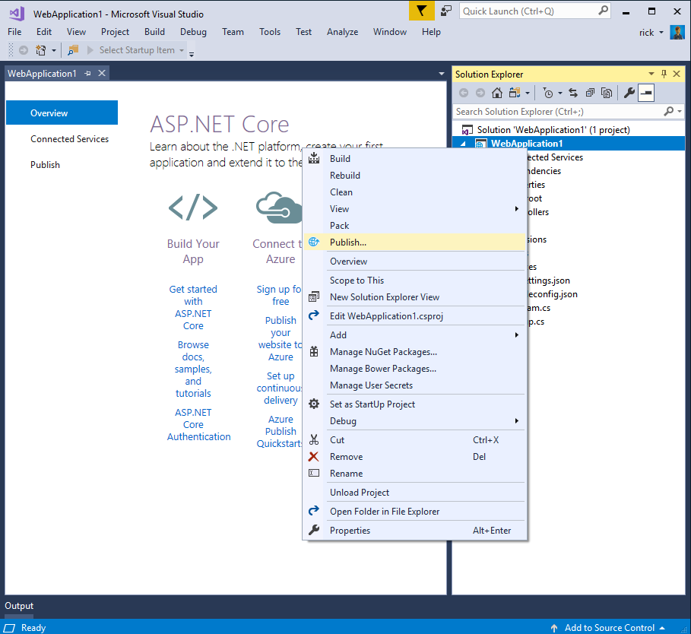
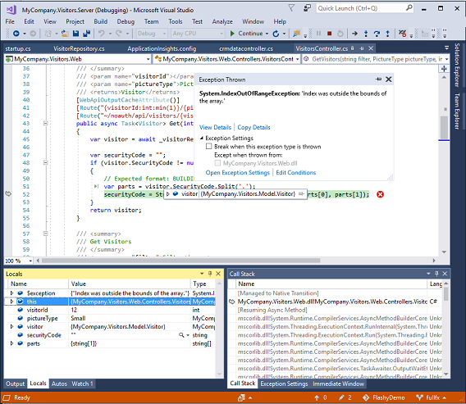
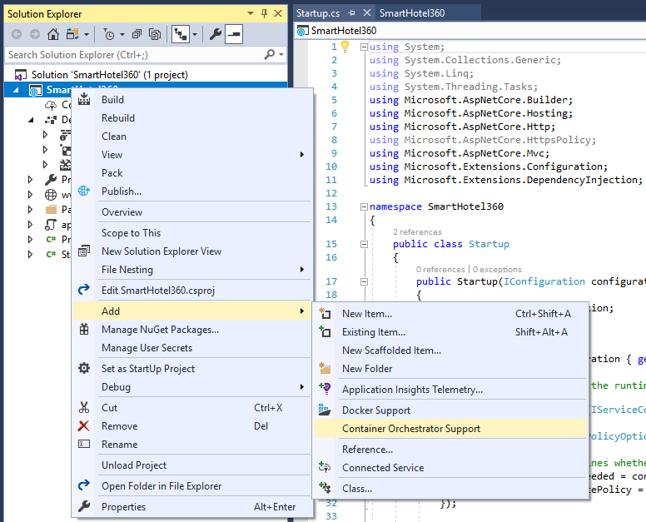
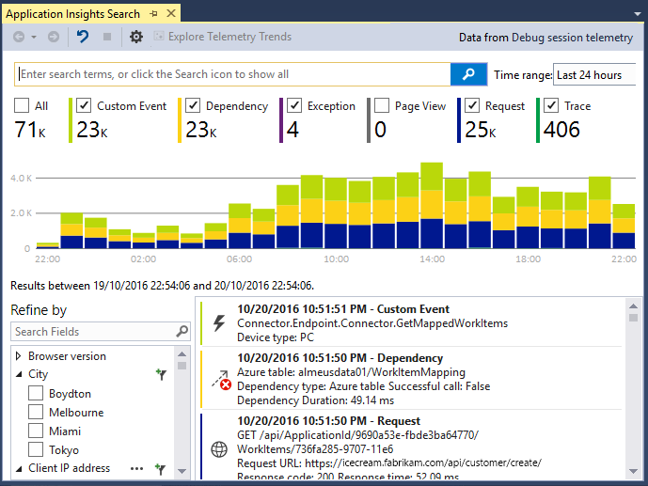
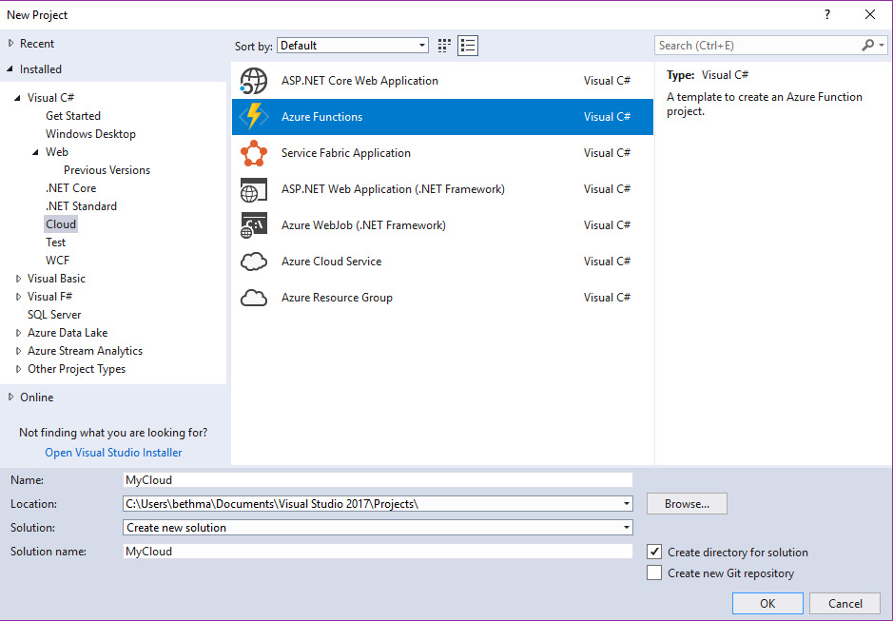
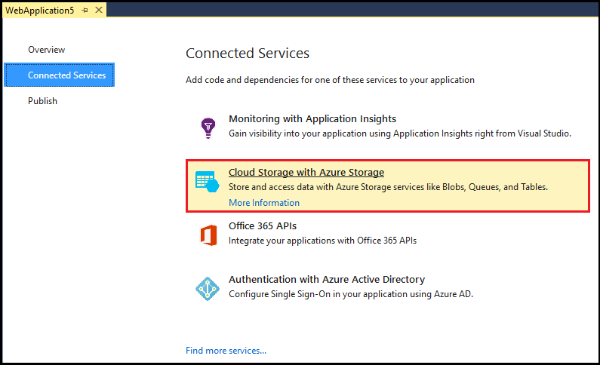
Accelerate your
development
cloud
Seamless Azure integration
Publish directly to Azure without leaving the IDE
Connected services
A new experience for easily discovering and extending your app with cloud services
Container tools
Quickly add Docker compose and container orchestrator support to your apps
App insights with Code Lens
Get a 360° view of your app that includes availability, performance and user behavior
Azure functions
Get started quickly with serverless using templates and tools for development and debugging
Snapshot debugging
Production debugging your cloud apps has never been so simple
Notes:
Of course there are a lot of great tools in Visual Studio for building applications. But what’s even better is the latest tools for building, monitoring, and managing your cloud applications. Whether that’s web applications hosted in App Service, or serverless Azure functions with C#, or containerized apps with Docker, we have you covered.

Slide 17

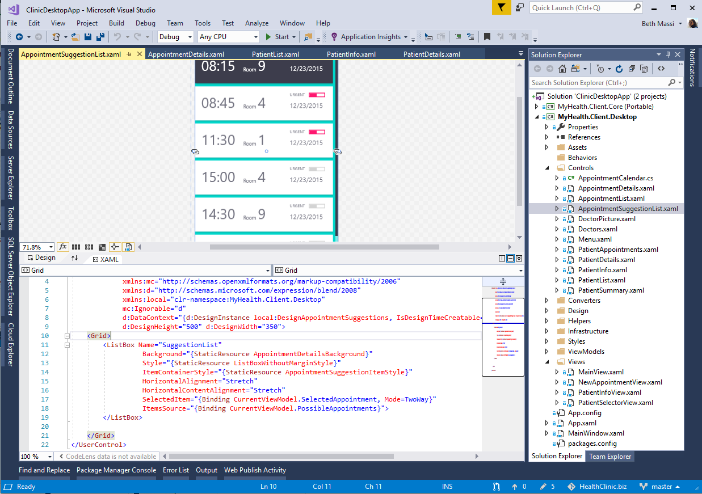
.NET open source
ANNOUNCING
Windows Forms
Windows Presentation Foundation
Windows UI XAML Library
Notes:
Today, I’m pleased to announce that we’re making WPF, WinForms, and Windows UI XAML controls open source.
These frameworks are used by millions of .NET developers, and open sourcing them has been one of our top community requests, so it’s great that now developers targeting windows desktop can adopt .NET Core.

Slide 18
.NET Core 3 preview available
ANNOUNCING
Windows desktop support with WPF and WinForms
Flexible deployment, side-by-side support and self-contained EXEs
Client-side web development with C# and Razor
Significant performance improvements
aka.ms/netcore3preview1
//BUILD update
Notes:
We’re also announcing today the first preview of .NET Core 3. It comes with significant updates to desktop and server workloads.
.NET Core 3 brings Windows desktop development to .NET Core, with support for WinForms and WPF.
It enables more flexible deployment with side-by-side and self-contained EXEs.
We also have new features on the server side, including composable UIs with ASP.NET Core with Razor Components, which will provide full-stack web development with .NET for the first time.

Slide 19
.NET Core
3
2
.NET Core is perfectly suited for the requirements of cloud-native, cross-platform workloads
.NET Core 3 expands supported workloads to include Windows Desktop, IoT, and AI
WEB
CLOUD
DESKTOP
IoT
AI
.NET CORE
.NET CORE 3
LIBRARIES
INFRASTRUCTURE
RUNTIME COMPONENTS
COMPILERS
LANGUAGES
Notes:
ANIMATED SLIDE – shows progression of entire .NET platform into .NET Core specific workloads.
.NET Core is our cross-platform, open source implementation of .NET and is perfectly suited for requirements of cloud-native, cross-platform services. We’ve made significant investments in the core performance as well as the web stack so that you can easily take advantage of cloud patterns and scale.
.NET Core 3 will expand on the supported workloads to include IoT, AI and Windows Desktop.

Slide 20
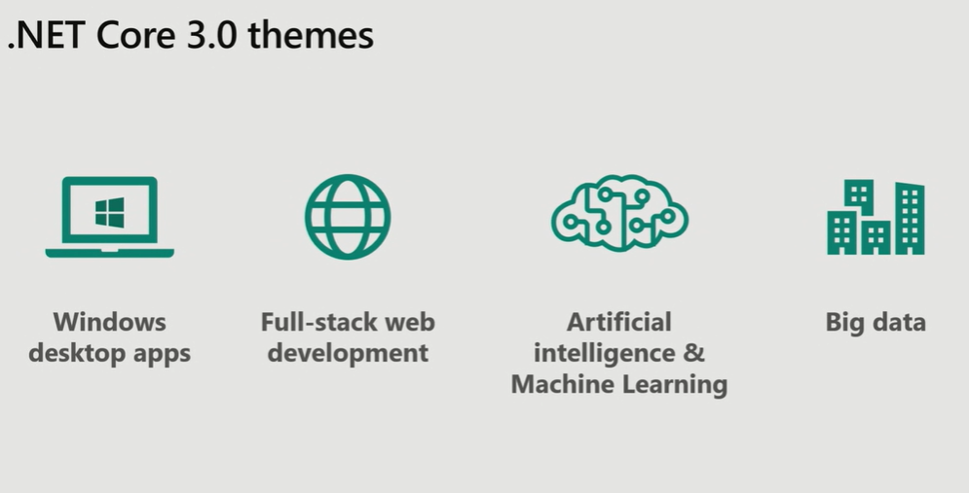
//BUILD update

Slide 21
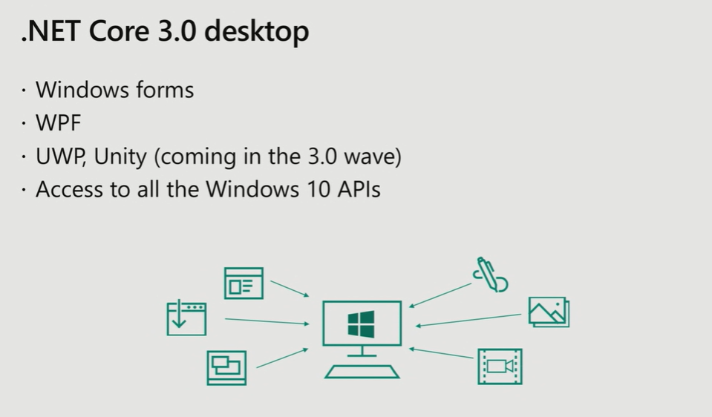
//BUILD update

Slide 22
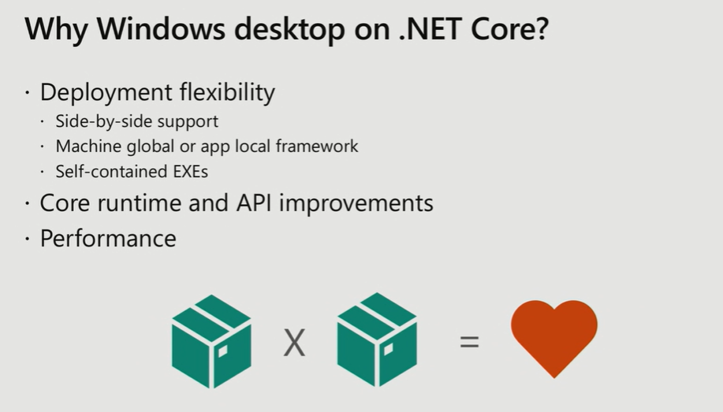
//BUILD update

Slide 23
Demo #2 .NET Core for WinForms
Notes:
HTTP/2, API security, show the meetup or GitHub API / show swagger
Bootstrap 4 template updates
Angular templates
-- 8min

Slide 24
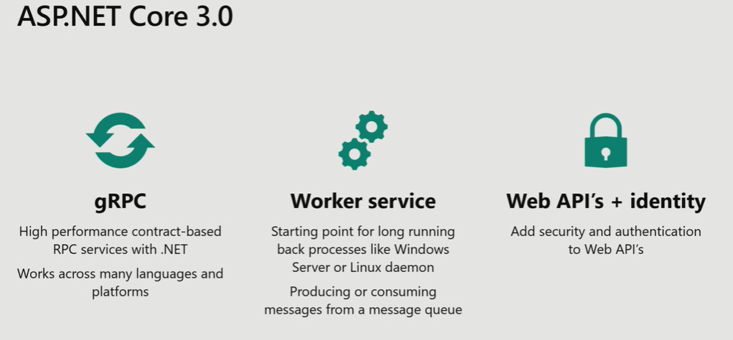
//BUILD update

Slide 25
ASP.NET Core 3.0 Razor Components
Build client-side Web UI in .NET
You don’t need to know AngularJS, React, Vue, etc.
Take advantage of stability and consistency of .NET
Runs in all browsers
Strongly typed on client and server
Share C# code with the client and the server
Web assembly (optional and experimental)
Native performance
Requires no plugin or code translation

Slide 26
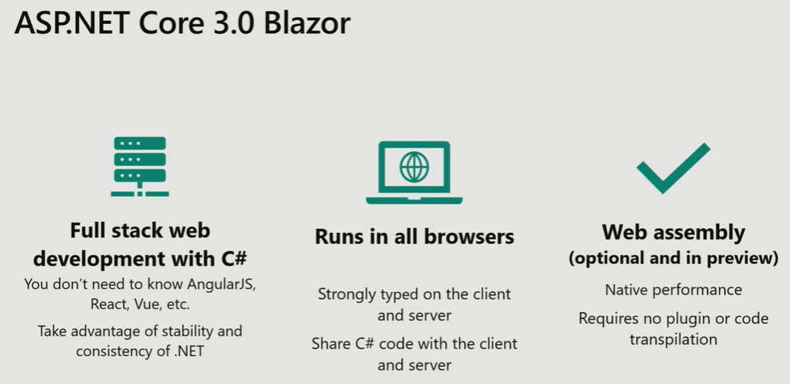
//BUILD update

Slide 27
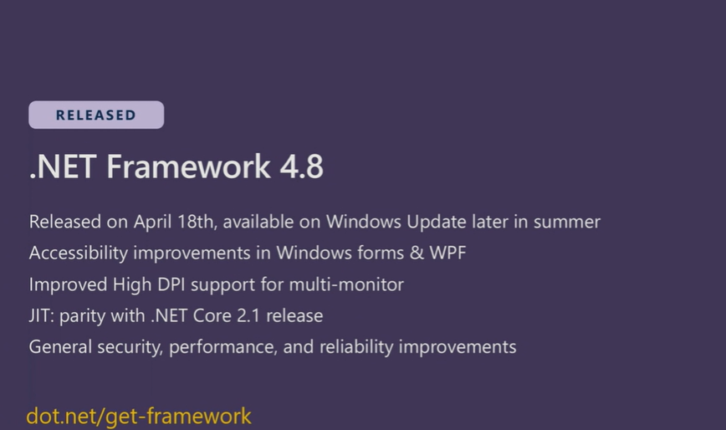

Slide 28

//BUILD update

Slide 29
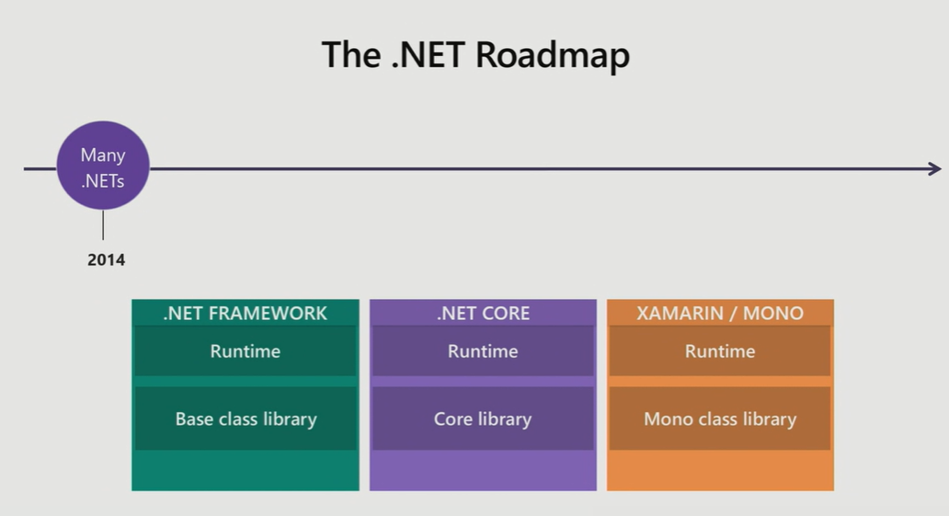

Slide 30
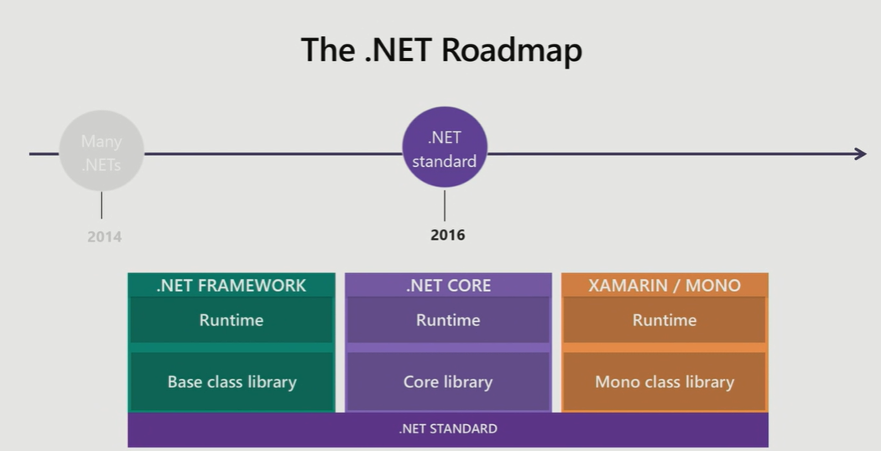

Slide 31
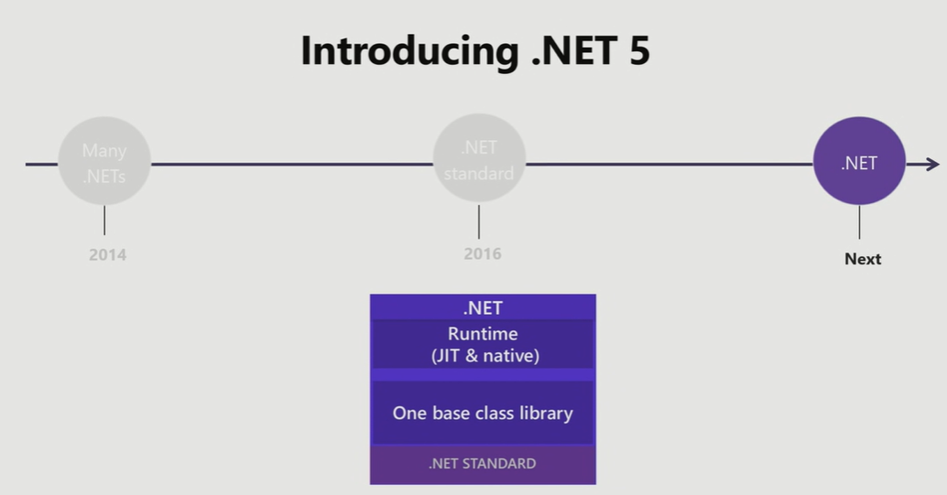
//BUILD update

Slide 32
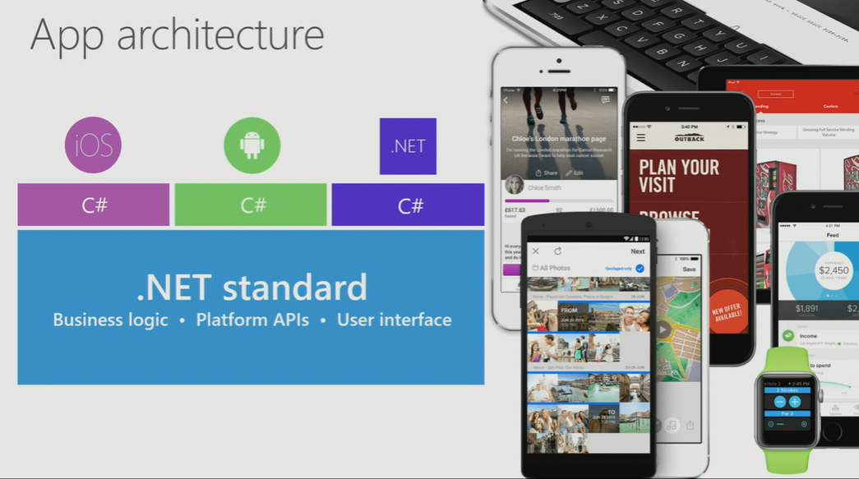
Notes:
5min

Slide 33
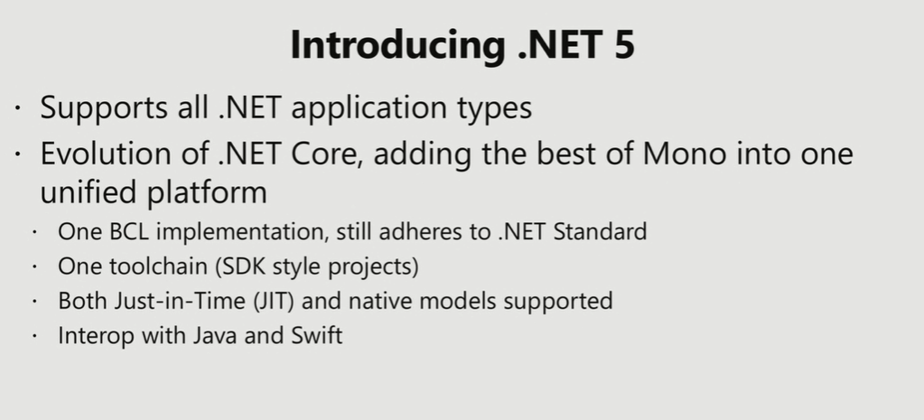
//BUILD update

Slide 34
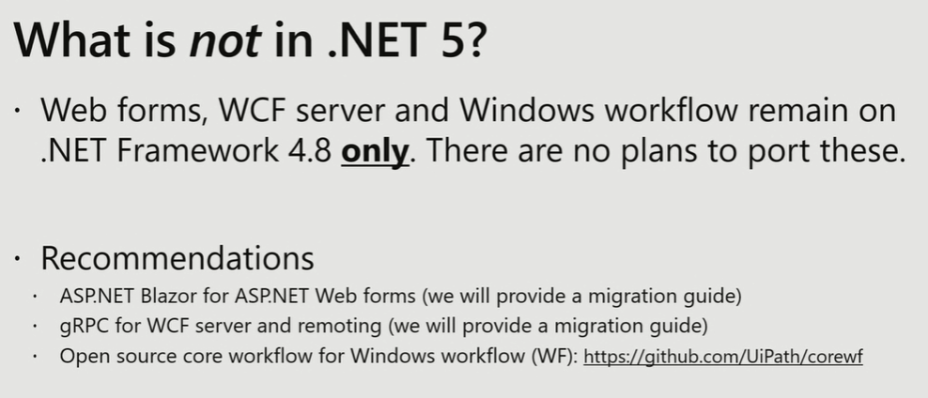
//BUILD update

Slide 35
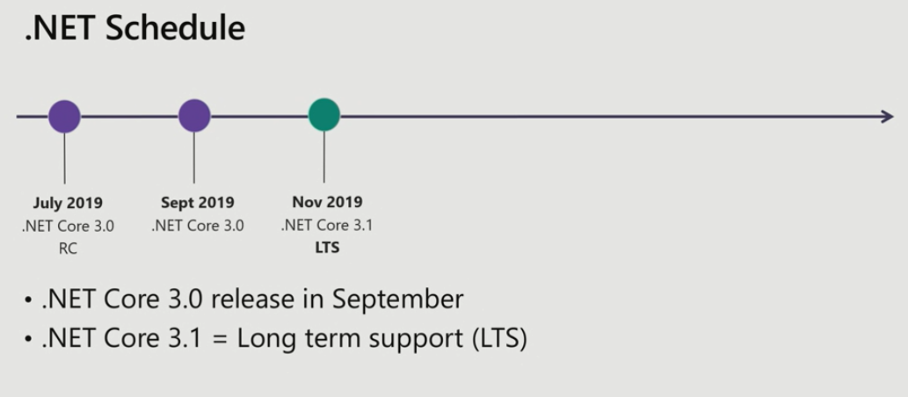
//BUILD update

Slide 36
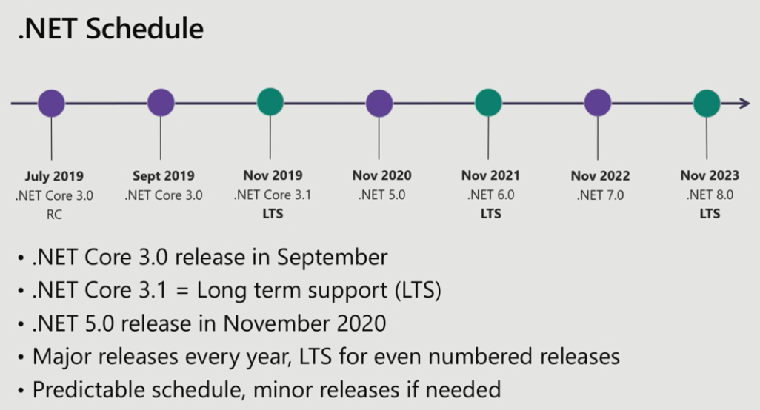
//BUILD update

Slide 37



Update .NET Framework apps
Modernize desktop apps with .NET Core 3
Highly compatible updates
Install .NET Core updates per your
needs
Existing app
.NET Framework 4.8
.NET Core 3
Windows-only
Windows-only
Cross-platform
Highly-compatible, targeted improvements, like last few releases
UWP
WEB
DATA
AI/ML
WPF
ASP.NET Core
EF 6
EF Core
ML.NET
Windows Forms
.NET STANDARD
.NET Framework support unchanged (supported for life of Windows)
Side-by-side support
Self-contained EXEs
XAML Islands—WinForms and WPF apps can host UWP controls
Full access to Windows 10 APIs
FEATURES IN BOTH FXs
//BUILD update
Notes:
.NET Framework will continue with highly-compatible targeted improvements like the last few releases and support will remain unchanged. You will be able to retarget existing apps to 4.8 and gain these improvements.
When you’re ready to move to .NET Core 3 (to take advantage of SxS install, interop between desktop app frameworks, and .NET Core performance) you can retarget and rebuild your apps to .NET Core.

Slide 38
Migrating a WinForm or WPF app to Core
For designers, map existing application into a new Core application
dotnet new WinForms
Delete all files except the .csproj file
Open the .csproj file
Stop the generation of AssemblyInfo using:
<GenerateAssemblyInfo>false</GenerateAssemblyInfo>
Maps files from existing application into the .NET Core application:
<ItemGroup>
<Compile Include="..\[Your Existing App]\**\*.cs" />
</ItemGroup>
Add any references to other projects or libraries
Now you can use the designers in the old project while running on Core in the new project

Slide 39
Demo #3 .NET Portability Analyzer
Notes:
HTTP/2, API security, show the meetup or GitHub API / show swagger
Bootstrap 4 template updates
Angular templates
-- 8min

Slide 40
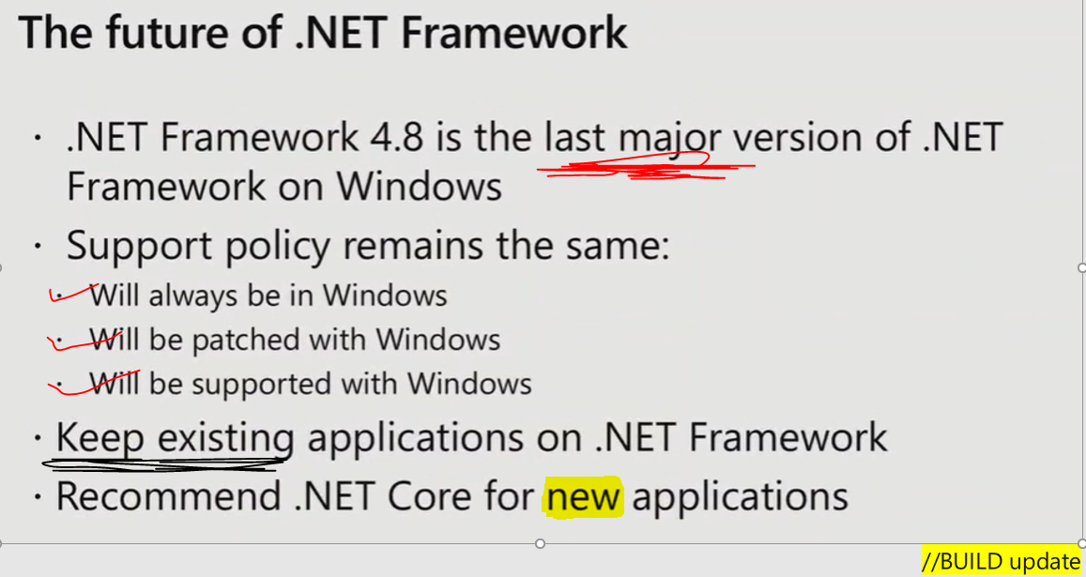

Slide 41
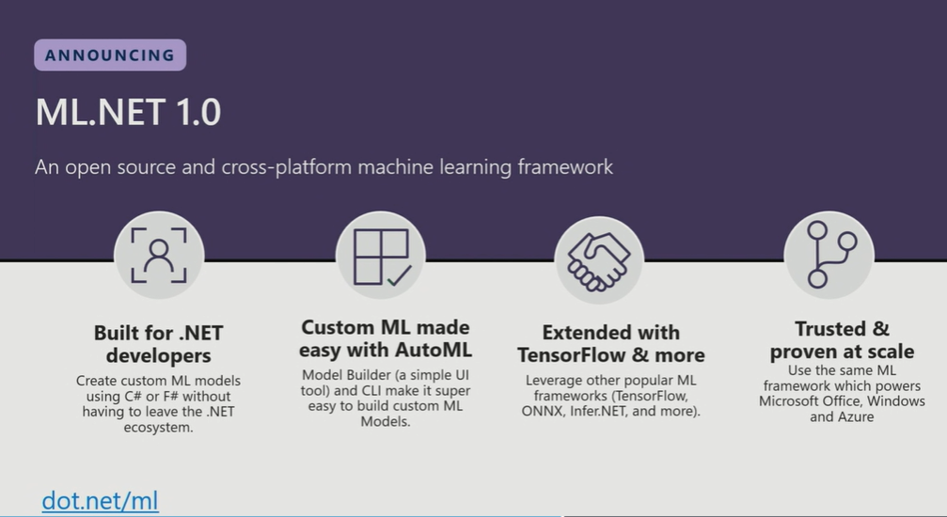
Notes:
However for many specific domains you need to build and train your own models. ML.NET is built for .NET developers to do exactly that. ML.NET is a Machine Learning framework for .NET developers to build custom ML Models.
ML.NET is developer focused which means we are going to optimize for common developer scenarios like recommendation, sentiment analysis
ML.NET is based upon a decade of internal goodness
ML.NET is open source and cross-platform

Slide 42
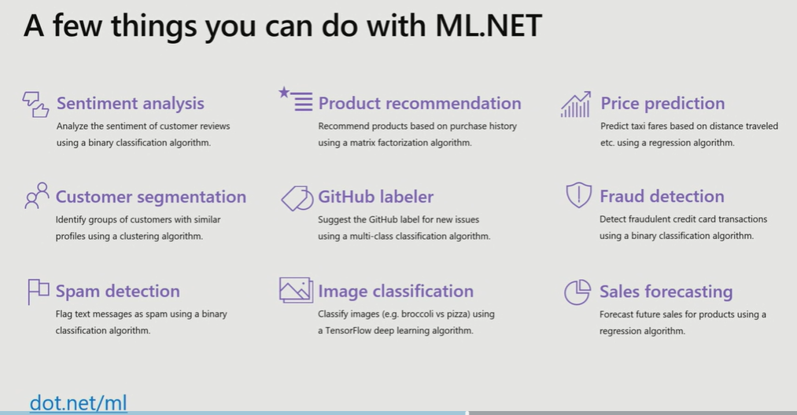
And more! Samples @ https://github.com/dotnet/machinelearning-samples
Notes:
However for many specific domains you need to build and train your own models. ML.NET is built for .NET developers to do exactly that. ML.NET is a Machine Learning framework for .NET developers to build custom ML Models.
ML.NET is developer focused which means we are going to optimize for common developer scenarios like recommendation, sentiment analysis
ML.NET is based upon a decade of internal goodness
ML.NET is open source and cross-platform

Slide 43
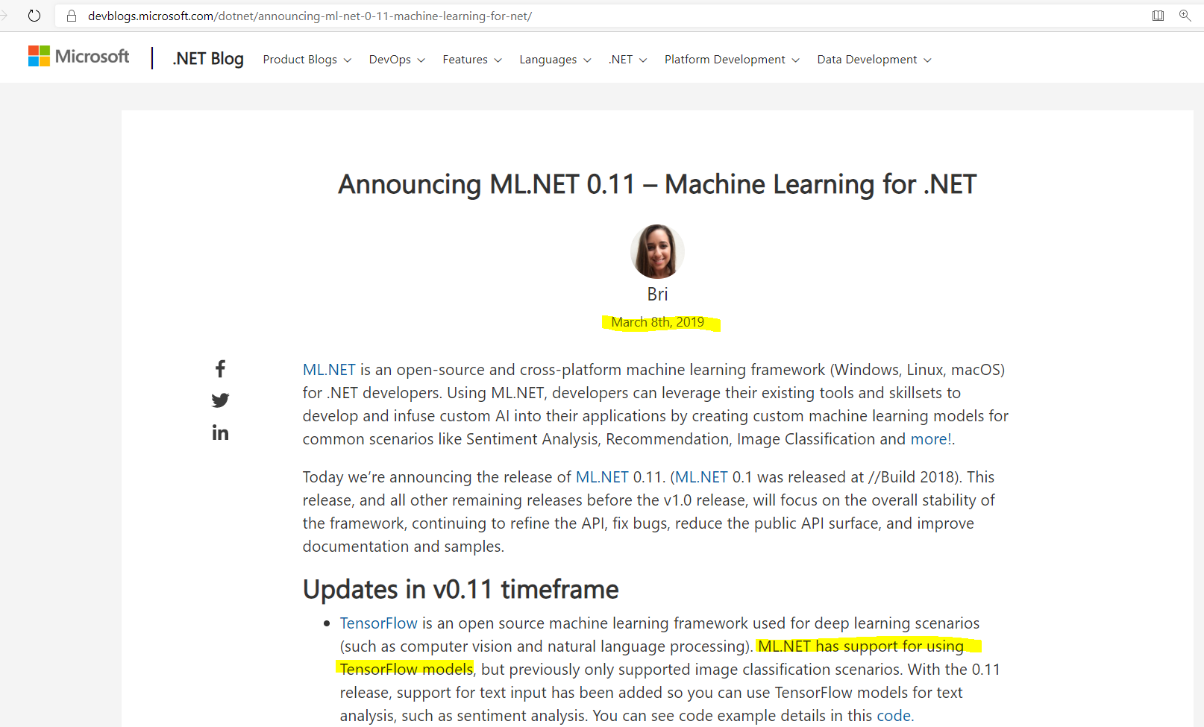
https://devblogs.microsoft.com/dotnet/announcing-ml-net-0-11-machine-learning-for-net/

Slide 44
Your platform for building anything
DESKTOP
WEB
CLOUD
MOBILE
GAMING
IoT
AI
.NET
www.dot.net
Notes:
So I hope what we showed you today reinforced our commitment to .NET for building anything you can imagine. It’s the best time to be a .NET developer and we have some very exciting innovations being made to the platform. The ecosystem is growing and it’s thanks to you! Please get involved and learn more on our website.

Slide 45
Summary
.NET Growth, .NET Open Source (.NET Foundation)
.NET Core 2.2 (GA)
Why .NET Core & ASP.NET Core (features)?
.NET Open Source (Winforms, WPF)
.NET Core 3 Preview, themes (desktop support)
Why Windows desktop on .NET Core?
ASP.NET Core 3.0?
What comes next for .NET?
.NET Roadmap
Introducing .NET 5 and schedule
Migrating Winforms or legacy applications to .NET Core
future of .NET Framework?
.NET Core (.NET 5) is the future of .NET ☺

Slide 46
Q&A
MahesKBlr

